Slide 1
Data Visualizations

Slide 2
Uncertainty

Slide 3
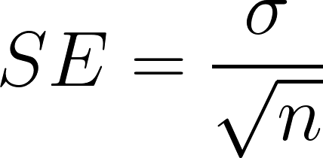
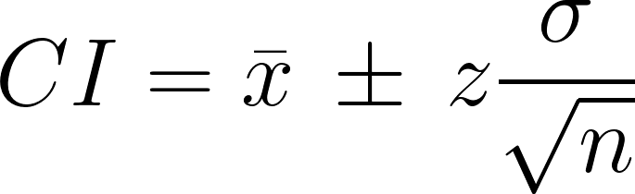
Standard error

Slide 4
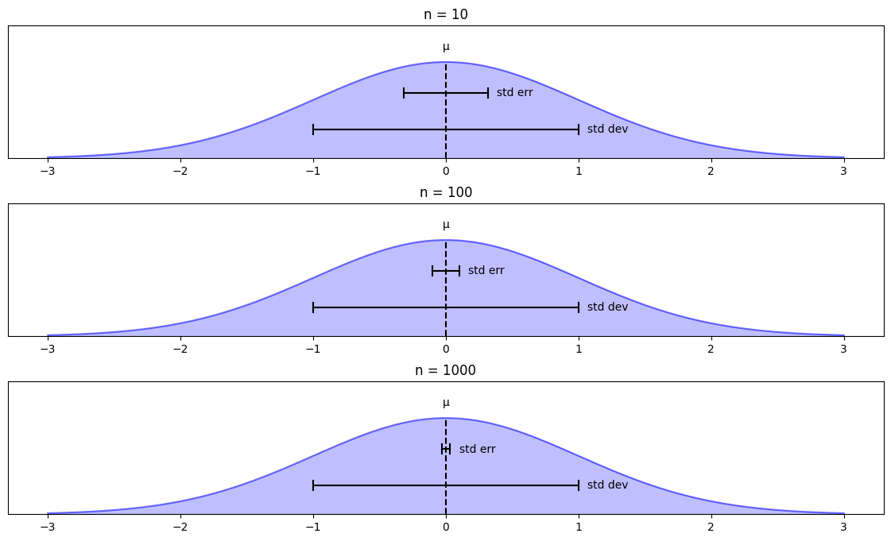
Standard error

Slide 5
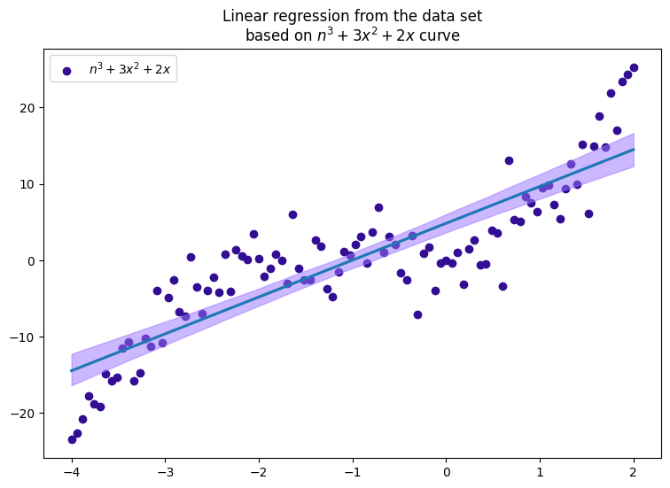
Uncertainty range for linear regression

Slide 6
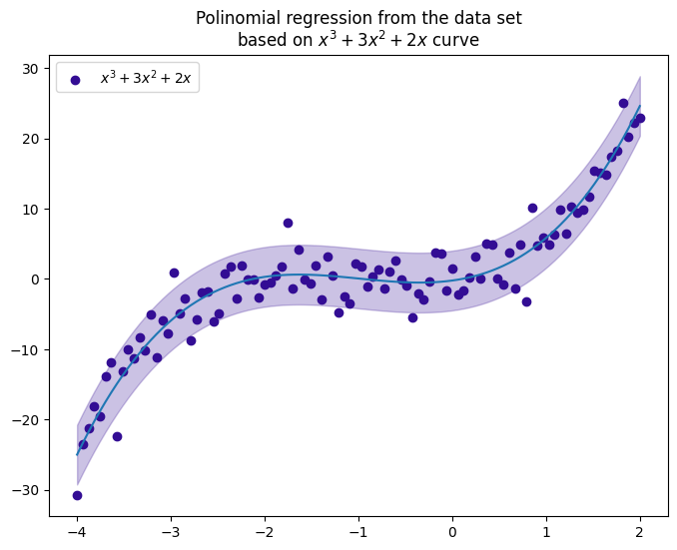
Uncertainty range for polynomial regression

Slide 7
Geospatial

Slide 8
Ways of representing
a map

Slide 9
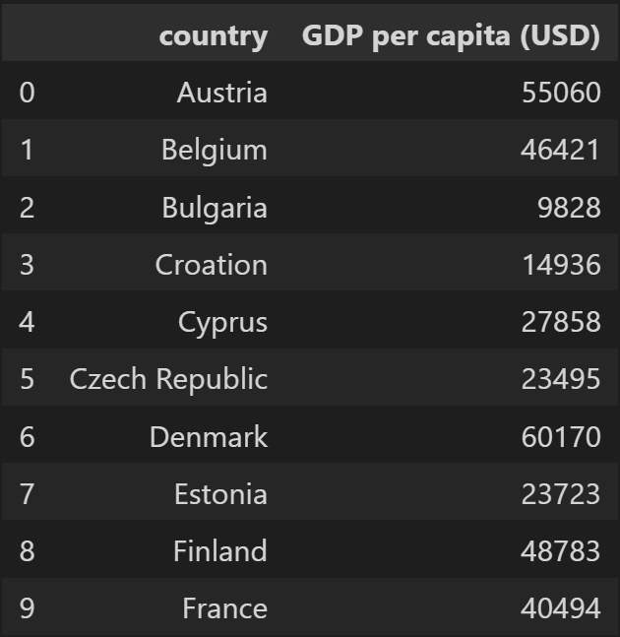
Why we need maps?

Slide 10
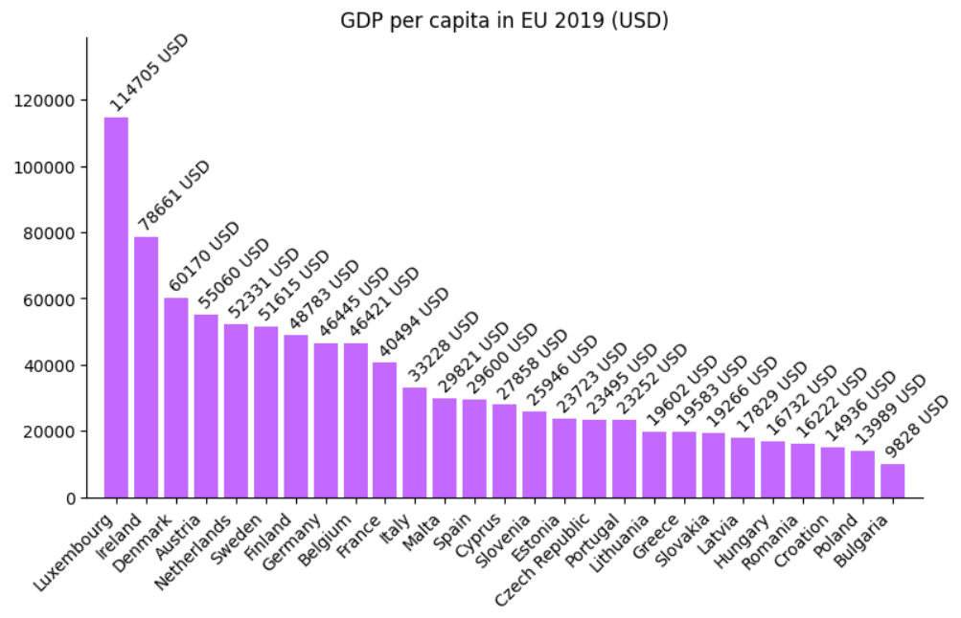
Why we need maps?

Slide 11
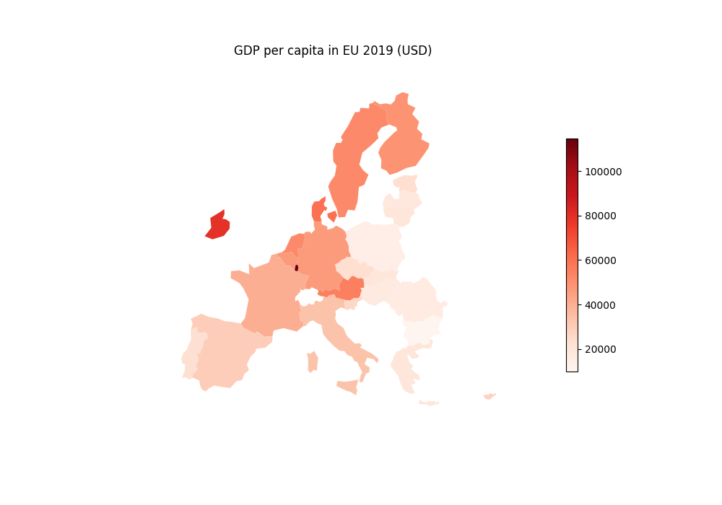
Why we need maps?

Slide 12
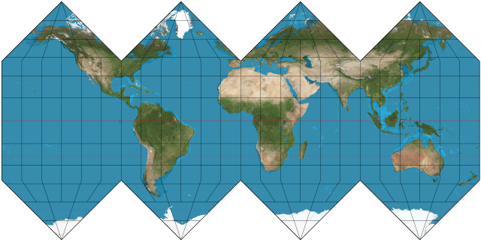
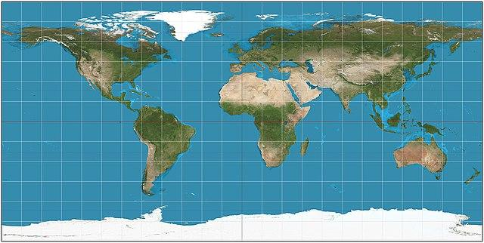
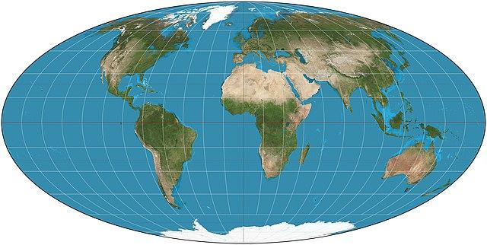
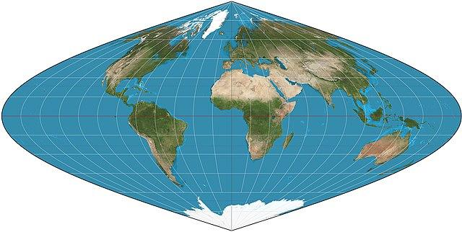
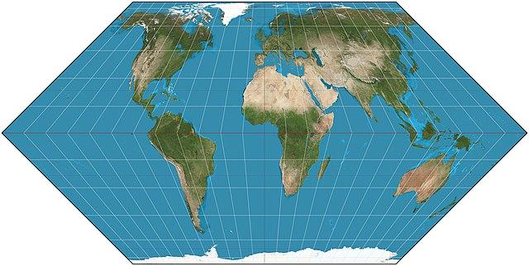
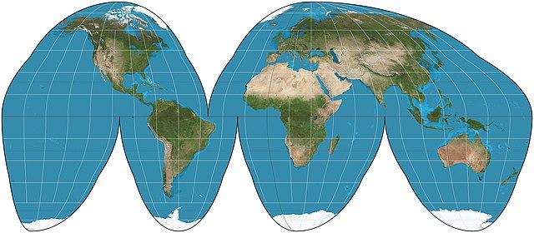
Many, many different projections…

Slide 13
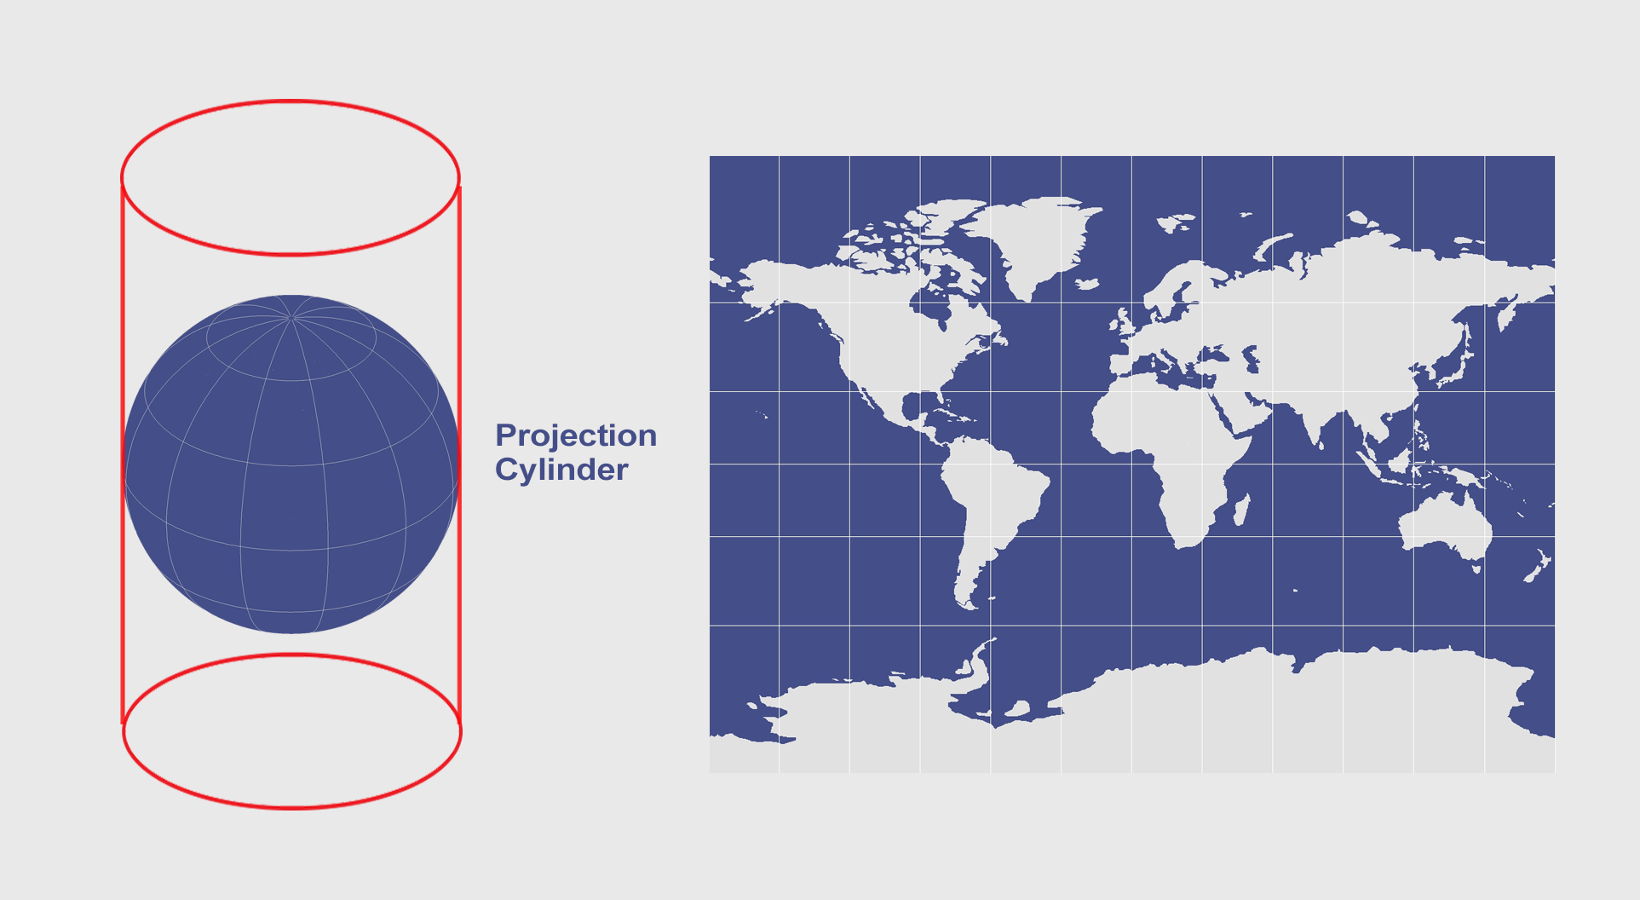
Mercator projection

Slide 14
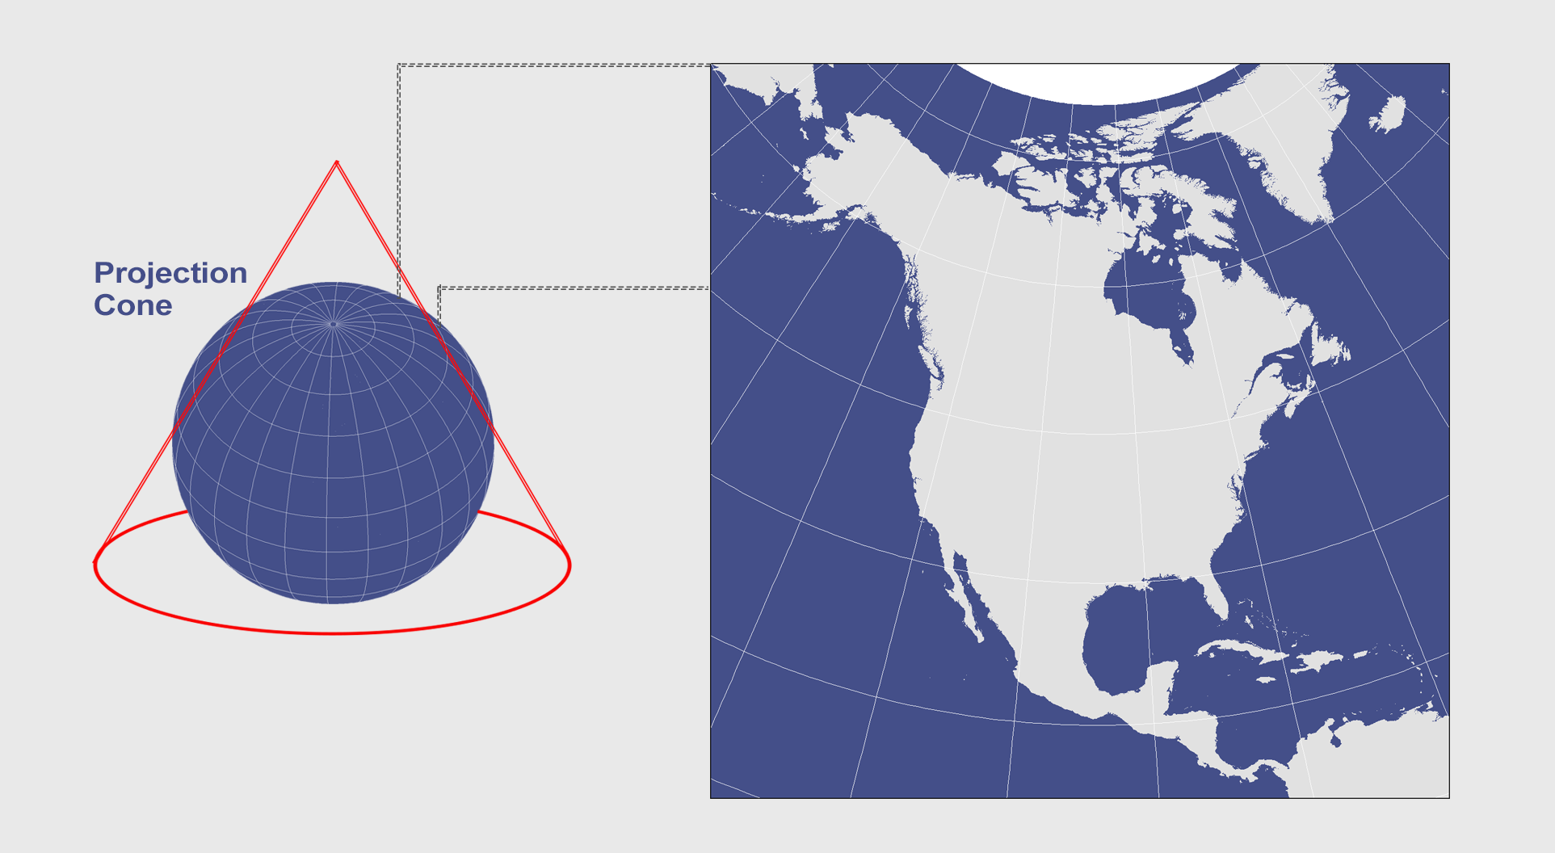
Albers projection

Slide 15
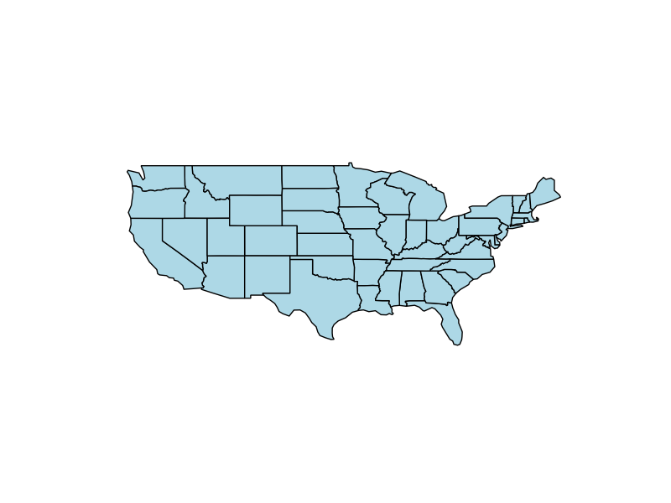
Mercator projection

Slide 16
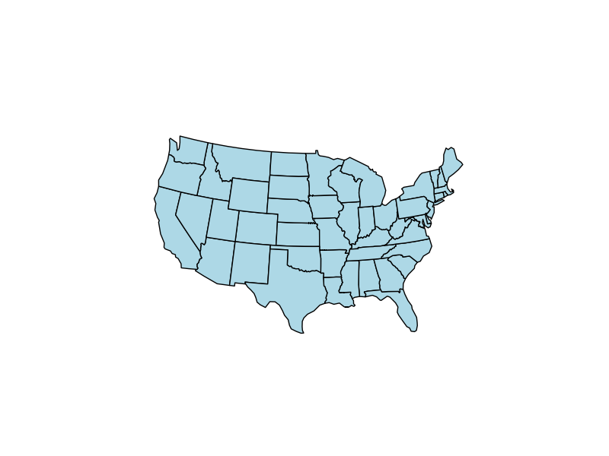
Albers projection

Slide 17
Mercator vs. Albers projection comparison

Slide 18
Types of map visualizations

Slide 19
Choropleth

Slide 20
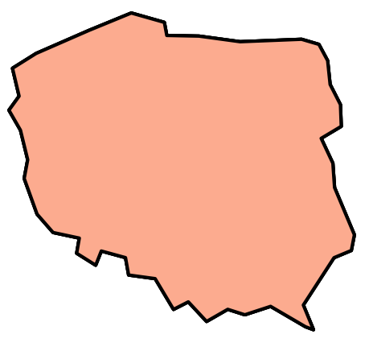
Choropleth

Slide 21
Choropleth
P₁(x₁, y₁)

Slide 22
Choropleth
P₂(x₂, y₂)
P₁(x₁, y₁)

Slide 23
Choropleth
P₃(x₃, y₃)
P₂(x₂, y₂)
P₁(x₁, y₁)

Slide 24
Choropleth
P₄(x₄, y₄)
P₃(x₃, y₃)
P₂(x₂, y₂)
P₁(x₁, y₁)

Slide 25
Choropleth
Poland = [
P₁(x₁, y₁),
P₂(x₂, y₂),
…,
P_{n}(x_{n}, y_{n})
]
P₄(x₄, y₄)
P₃(x₃, y₃)
P₂(x₂, y₂)
P₁(x₁, y₁)

Slide 26
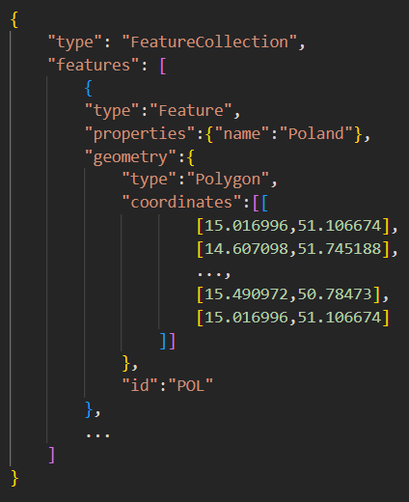
GeoJSON

Slide 27
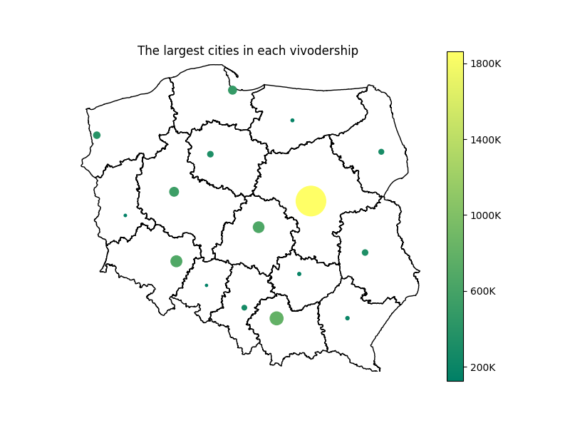
Bubble graph on map

Slide 28
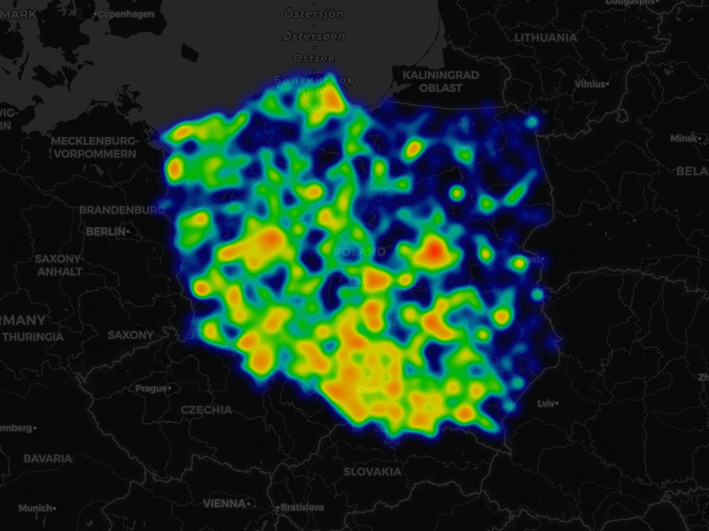
Cartogram heatmap

Slide 29

Cartogram heatmap

Slide 30
References
Information sources:
[1] Wes McKinney, Python for Data Analysis, 3E (2022), Wes’s Blog
[2] Claus O. Wilke, Fundamentals of Data Visualization (2019), Claus Website
[3] Geoplot documentation
[4] Map projection, Wikipedia, access date: 23.10.2024
[5] Mercator projection, Wikipedia, access date: 23.10.2024
[6] Albers projection, Wikipedia, access date: 23.10.2024
[7] List of map projections, Wikipedia, access date: 23.10.2024
[8] Cylindrical Projections Mercator, Miller and Pseudocylindrical (2024), GISGeography
[9] Conic Projection Lambert, Albers and Polyconic (2023), GISGeography
Data sources:
[10] Rachael Tatman, Chocolate Bar Ratings (2017), Kaggle
[11] Chris Riederer, world.geo.json, Github
[12] Piotr Patrzyk, polska-geosjon, Github
Other:
[13] My private notes about data visualization an examples
Presentation author: Maksymilian Norkiewicz

